Slide 1
Language Modeling
Introduction to N-grams

Slide 2
Probabilistic Language Models
Today’s goal: assign a probability to a sentence
Machine Translation:
P(high winds tonite) > P(large winds tonite)
Spell Correction
The office is about fifteen minuets from my house
P(about fifteen minutes from) > P(about fifteen minuets from)
Speech Recognition
P(I saw a van) >> P(eyes awe of an)
+ Summarization, question-answering, etc., etc.!!
Why?

Slide 3
Probabilistic Language Modeling
Goal: compute the probability of a sentence or sequence of words:
P(W) = P(w₁,w₂,w₃,w₄,w₅…w_{n})
Related task: probability of an upcoming word:
P(w₅|w₁,w₂,w₃,w₄)
A model that computes either of these:
P(W) or P(w_{n}|w₁,w₂…w_{n-1}) is called a language model.
Better: the grammar But language model or LM is standard
Models that assign probabilities to sequences of words are called language models or LMs.

Slide 4
How to compute P(W)
How to compute this joint probability:
P(its, water, is, so, transparent, that)
Intuition: let’s rely on the Chain Rule of Probability

Slide 5
Reminder: The Chain Rule
Recall the definition of conditional probabilities
p(B|A) = P(A,B)/P(A) Rewriting: P(A,B) = P(A)P(B|A)
More variables:
P(A,B,C,D) = P(A)P(B|A)P(C|A,B)P(D|A,B,C)
The Chain Rule in General
P(x₁,x₂,x₃,…,x_{n}) = P(x₁)P(x₂|x₁)P(x₃|x₁,x₂)…P(x_{n}|x₁,…,x_{n-1})

Slide 6
The Chain Rule applied to compute joint probability of words in sentence
P(“its water is so transparent”) =
P(its) × P(water|its) × P(is|its water)
× P(so|its water is) × P(transparent|its water is so)

Slide 7
How to estimate these probabilities
Could we just count and divide?
No! Too many possible sentences!
We’ll never see enough data for estimating these

Slide 8
An n-gram is a sequence n-gram of n words
a 2-gram (which we’ll call bigram) is a two-word sequence of words like “please turn”, “turn your”, or ”your homework”
a 3-gram (a trigram) is a three-word sequence of words like “please turn your”, or “turn your homework”.

Slide 9
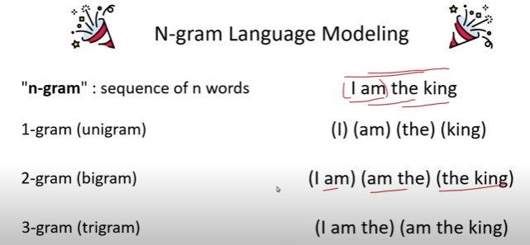

Slide 10
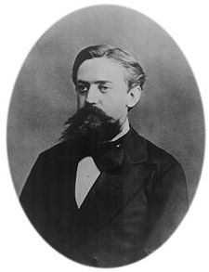
Markov Assumption
Simplifying assumption:
Or maybe
Andrei Markov

Slide 11
Markov Assumption
In other words, we approximate each component in the product

Slide 12
Simplest case: Unigram model
Some automatically generated sentences from a unigram model
fifth, an, of, futures, the, an, incorporated, a, a, the, inflation, most, dollars, quarter, in, is, mass
thrift, did, eighty, said, hard, 'm, july, bullish
that, or, limited, the

Slide 13
Bigram model
Condition on the previous word:
texaco, rose, one, in, this, issue, is, pursuing, growth, in, a, boiler, house, said, mr., gurria, mexico, 's, motion, control, proposal, without, permission, from, five, hundred, fifty, five, yen
outside, new, car, parking, lot, of, the, agreement, reached
this, would, be, a, record, november

Slide 14
N-gram models
We can extend to trigrams, 4-grams, 5-grams
In general this is an insufficient model of language
because language has long-distance dependencies:
“The computer which I had just put into the machine room on the fifth floor crashed.”
But we can often get away with N-gram models

Slide 15
Language Modeling
Estimating N-gram Probabilities

Slide 16
Estimating bigram probabilities
The Maximum Likelihood Estimate

Slide 17
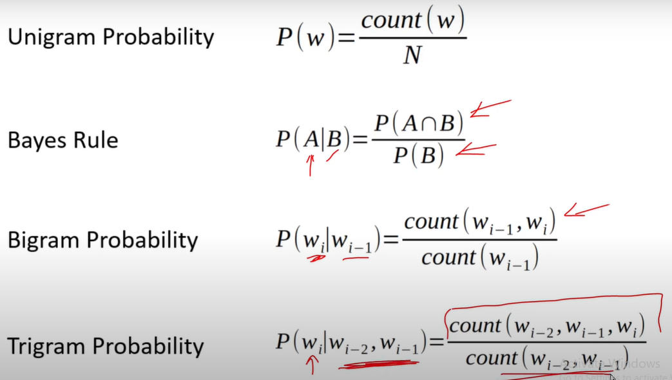

Slide 18
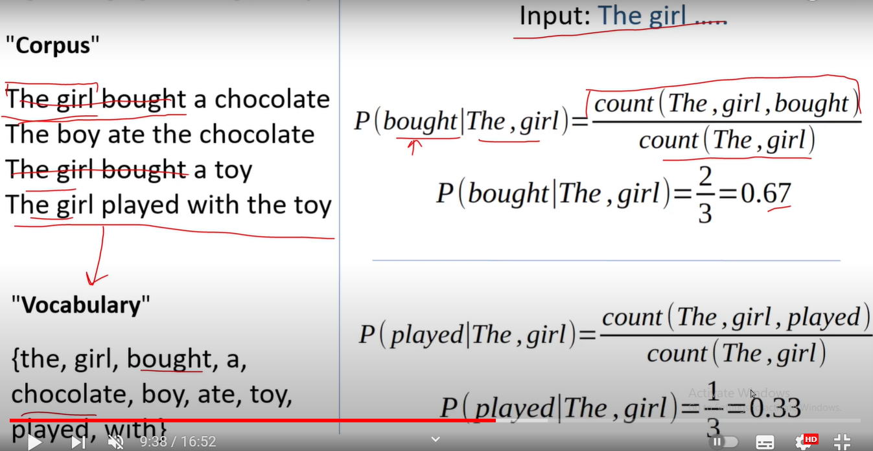

Slide 19

An example
<s> I am Sam </s>
<s> Sam I am </s>
<s> I do not like green eggs and ham </s>

Slide 20
More examples: Berkeley Restaurant Project sentences
can you tell me about any good cantonese restaurants close by
mid priced thai food is what i’m looking for
tell me about chez panisse
can you give me a listing of the kinds of food that are available
i’m looking for a good place to eat breakfast
when is caffe venezia open during the day

Slide 21
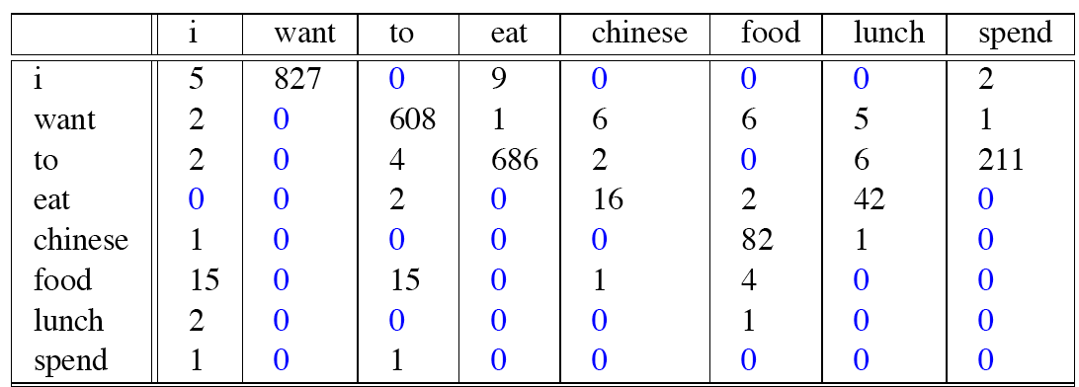
Raw bigram counts
Out of 9222 sentences

Slide 22
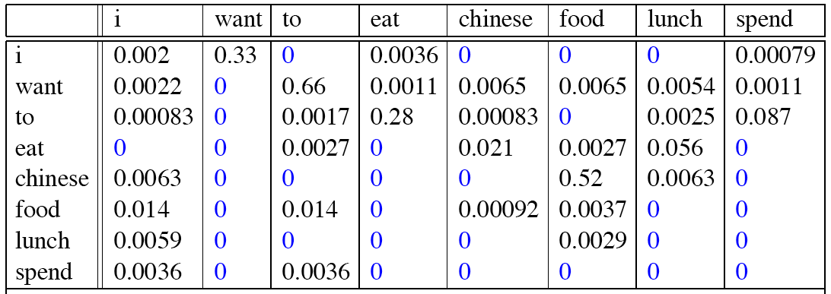
Raw bigram probabilities
Normalize by unigrams:
Result:

Slide 23
Bigram estimates of sentence probabilities
P(<s> I want english food </s>) =
P(I|<s>)
× P(want|I)
× P(english|want)
× P(food|english)
× P(</s>|food)
= .000031

Slide 24
What kinds of knowledge?
P(english|want) = .0011
P(chinese|want) = .0065
P(to|want) = .66
P(eat | to) = .28
P(food | to) = 0
P(want | spend) = 0
P (i | <s>) = .25

Slide 25
Practical Issues
We do everything in log space
Avoid underflow
(also adding is faster than multiplying)

Slide 26
Language Modeling Toolkits
SRILM
http://www.speech.sri.com/projects/srilm/
KenLM
https://kheafield.com/code/kenlm/
Google Book N Grams
http://ngrams.googlelabs.com/

Slide 27
Language Modeling
Evaluating Language Models

Slide 28
Extrinsic Evaluation
The best way to evaluate the performance of a language model is to embed it in an application and measure how much the application improves. Such end-to-end evaluation is called extrinsic evaluation.
It is the only way to know if a particular improvement in a component is really going to help the task at hand.
Thus, for speech recognition, we can compare the performance of two language models by running the speech recognizer twice, once with each language model, and seeing which gives the more accurate transcription.

Slide 29
Intrinsic evaluation
Unfortunately, running big NLP systems end-to-end is often very expensive.
Instead, it would be nice to have a metric that can be used to quickly evaluate potential improvements in a language model.
An intrinsic evaluation metric is one that mea- intrinsic evaluation sures the quality of a model independent of any application

Slide 30
Intrinsic Evaluation: How good is our model?
Does our language model prefer good sentences to bad ones?
Assign higher probability to “real” or “frequently observed” sentences
Than “ungrammatical” or “rarely observed” sentences?
We train parameters of our model on a training set.
We test the model’s performance on data we haven’t seen.
A test set is an unseen dataset that is different from our training set, totally unused.
An evaluation metric tells us how well our model does on the test set.

Slide 31
Extrinsic evaluation of N-gram models
Best evaluation for comparing models A and B
Put each model in a task
spelling corrector, speech recognizer, MT system
Run the task, get an accuracy for A and for B
How many misspelled words corrected properly
How many words translated correctly
Compare accuracy for A and B

Slide 32
Difficulty of extrinsic (in-vivo) evaluation of N-gram models
Extrinsic evaluation
Time-consuming; can take days or weeks
So
Sometimes use intrinsic evaluation: perplexity
Bad approximation
unless the test data looks just like the training data
So generally only useful in pilot experiments
But is helpful to think about.

Slide 33
Intuition of Perplexity
The Shannon Game:
How well can we predict the next word?
Unigrams are terrible at this game. (Why?)
A better model of a text
is one which assigns a higher probability to the word that actually occurs
mushrooms 0.1
pepperoni 0.1
anchovies 0.01
….
fried rice 0.0001
….
and 1e-100
I always order pizza with cheese and ____
The 33rd President of the US was ____
I saw a ____

Slide 34
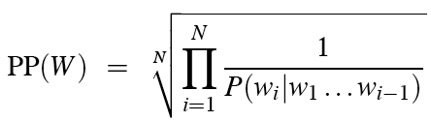
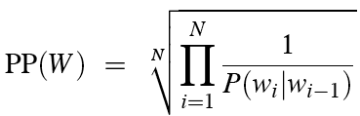
Perplexity
The best language model is one that best predicts an unseen test set
Gives the highest P(sentence)
Perplexity is the inverse probability of the test set, normalized by the number of words:
Chain rule:
For bigrams:
Minimizing perplexity is the same as maximizing probability

Slide 35
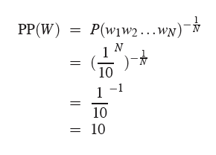
Perplexity as branching factor
Let’s suppose a sentence consisting of random digits
What is the perplexity of this sentence according to a model that assign P=1/10 to each digit?

Slide 36
Lower perplexity = better model
Training 38 million words, test 1.5 million words, WSJ
N-gram Order | Unigram | Bigram | Trigram
Perplexity | 962 | 170 | 109

Slide 37
Language Modeling
Smoothing: Add-one (Laplace) smoothing

Slide 38
Laplace Smoothing(add-one Smoothing)
The simplest way to do smoothing is to add one to all the n-gram counts, before we normalize them into probabilities.
All the counts that used to be zero will now have a count of 1, the counts of 1 will be 2, and so on.
This algorithm is called Laplace smoothing

Slide 39


Laplace smoothing to unigram probabilities
MLE estimate: The unigram probability of the Word wi is its count ci normalized by the total number of word tokens N
Add one Estimate: Laplace smoothing merely adds one to each count (so its alternate name add-one smoothing). Since V words in the vocabulary and each one was incremented, we also need to adjust the denominator to take into account the extra V observations.

Slide 40
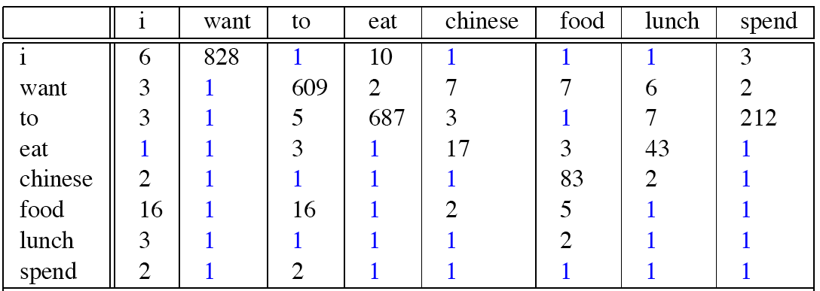
Berkeley Restaurant Corpus: Laplace smoothed bigram counts

Slide 41

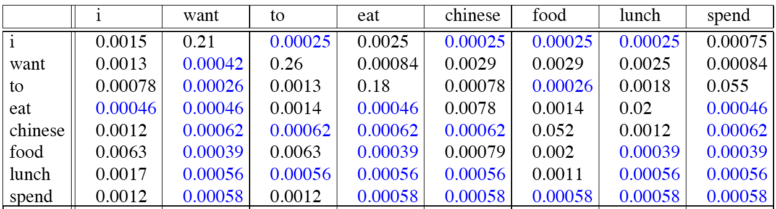
Laplace-smoothed bigrams
For add-one smoothed bigram counts, we need to augment the unigram count by the number of total word types in the vocabulary V
Add-one smoothed bigram probabilities for eight of the words (out of V = 1446) in the BeRP corpus of 9332 sentences. Previously-zero probabilities are in gray

Slide 42

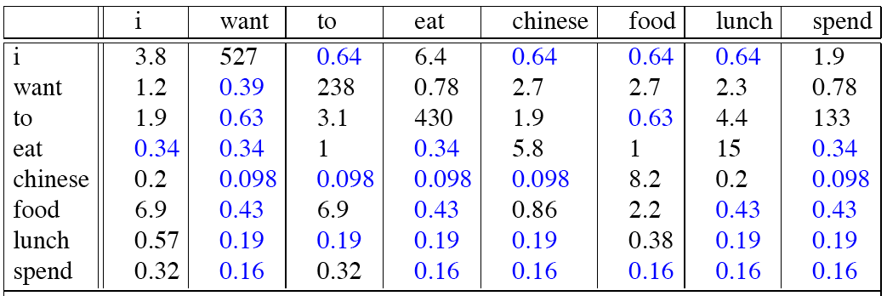
Reconstituted counts
It is often convenient to reconstruct the count matrix so we can see how much a smoothing algorithm has changed the original counts.

Slide 43
Compare with raw bigram counts
Notes:
C(want to) went from 608 to 238, P(to|want) from .66 to .26!
Discount d= c*/c
d for “chinese food” =.10!!! A 10x reduction

Slide 44
Add-1 estimation is a blunt instrument
So add-1 isn’t used for N-grams:
We’ll see better methods
But add-1 is used to smooth other NLP models
For text classification
In domains where the number of zeros isn’t so huge.

Slide 45

Add-k smoothing
One alternative to add-one smoothing is to move a bit less of the probability mass from the seen to the unseen events.
Instead of adding 1 to each count, we add a fractional count k (.5? .05? .01?).
This algorithm is therefore called add-k.
Add-k smoothing requires that we have a method for choosing k; this can be done, for example, by optimizing on a devset. Although add-k is useful for some tasks (including text classification), it turns out that it still doesn’t work well for language modeling, generating counts with poor variances and often inappropriate discounts

Slide 46
Language Modeling
Backoff and Interpolation

Slide 47
Backoff and Interpolation
Sometimes it helps to use less context
Condition on less context for contexts you haven’t learned much about
Backoff:
use trigram if you have good evidence,
otherwise bigram, otherwise unigram
In other words, we only “back off” to a lower-order n-gram if we have zero evidence for a higher-order n-gram.
Interpolation:
we always mix the probability estimates from all the n-gram estimators, weighting and combining
mix unigram, bigram, trigram
Interpolation works better

Slide 48
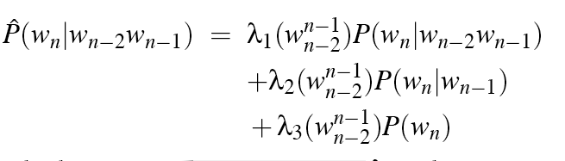
Linear Interpolation
Simple interpolation
Lambdas conditional on context:

Slide 49
How to set the lambdas?
Use a held-out corpus
Choose λs to maximize the probability of held-out data:
Fix the N-gram probabilities (on the training data)
Then search for λs that give largest probability to held-out set:
Training Data
Held-Out Data
Test
Data
There are various ways to find this optimal set of λs.
One way is to use the EM algorithm, an iterative learning algorithm that converges on locally optimal λs

Slide 50
Katz backoff
Just as with add-one smoothing, if the higher-order n-grams aren’t discounted and we just used the undiscounted MLE probability, then as soon as we replaced an n-gram which has zero probability with a lower-order n-gram, we would be adding probability mass, and the total probability assigned to all possible strings by the language model would be greater than 1!
In addition to this explicit discount factor, we’ll need a function α to distribute this probability mass to the lower order n-grams.
This kind of backoff with discounting is also called Katz backoff. In Katz backoff we rely on a discounted probability P ∗ if we’ve seen this n-gram before (i.e., if we have non-zero counts).

Slide 51
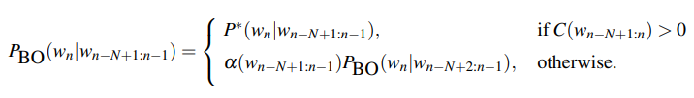
Katz backoff is often combined with a smoothing method called Good-Turing.
The combined Good-Turing backoff algorithm involves quite detailed computation for estimating the Good-Turing smoothing and the P ∗ and α values.

